Slide 2
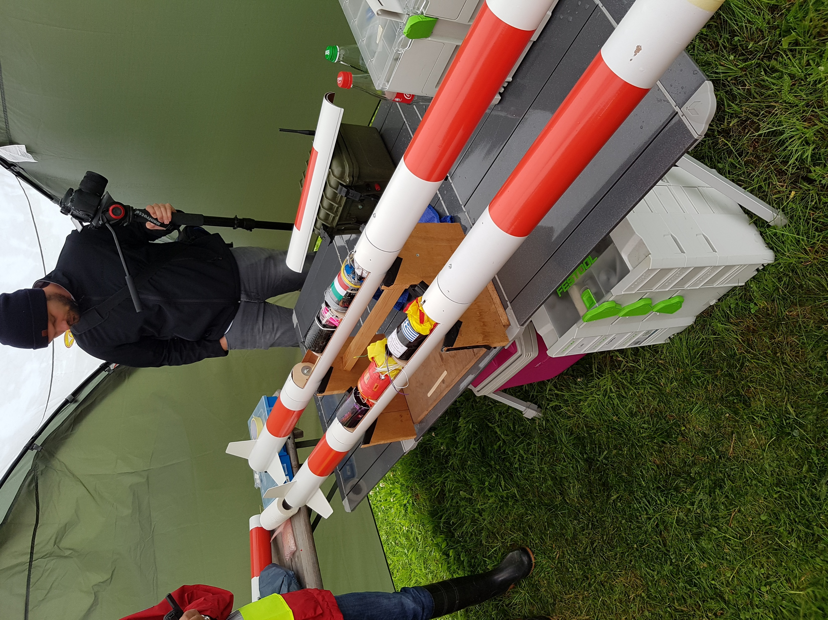
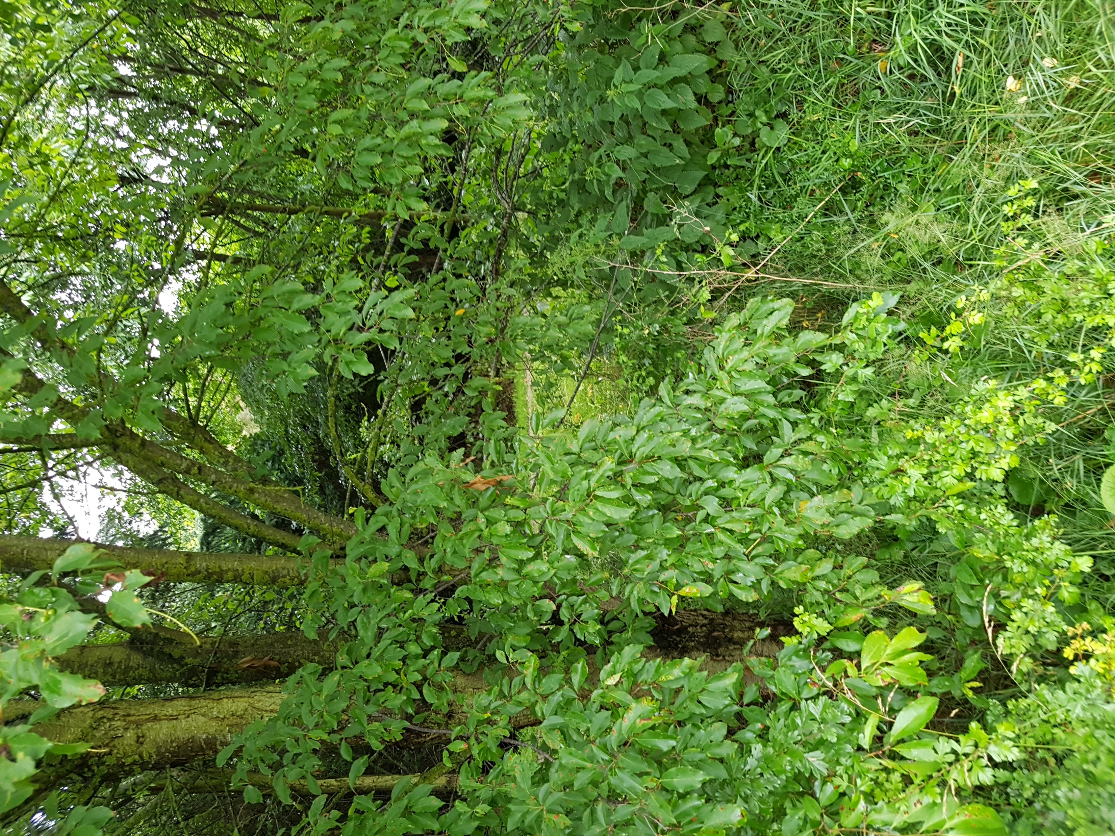
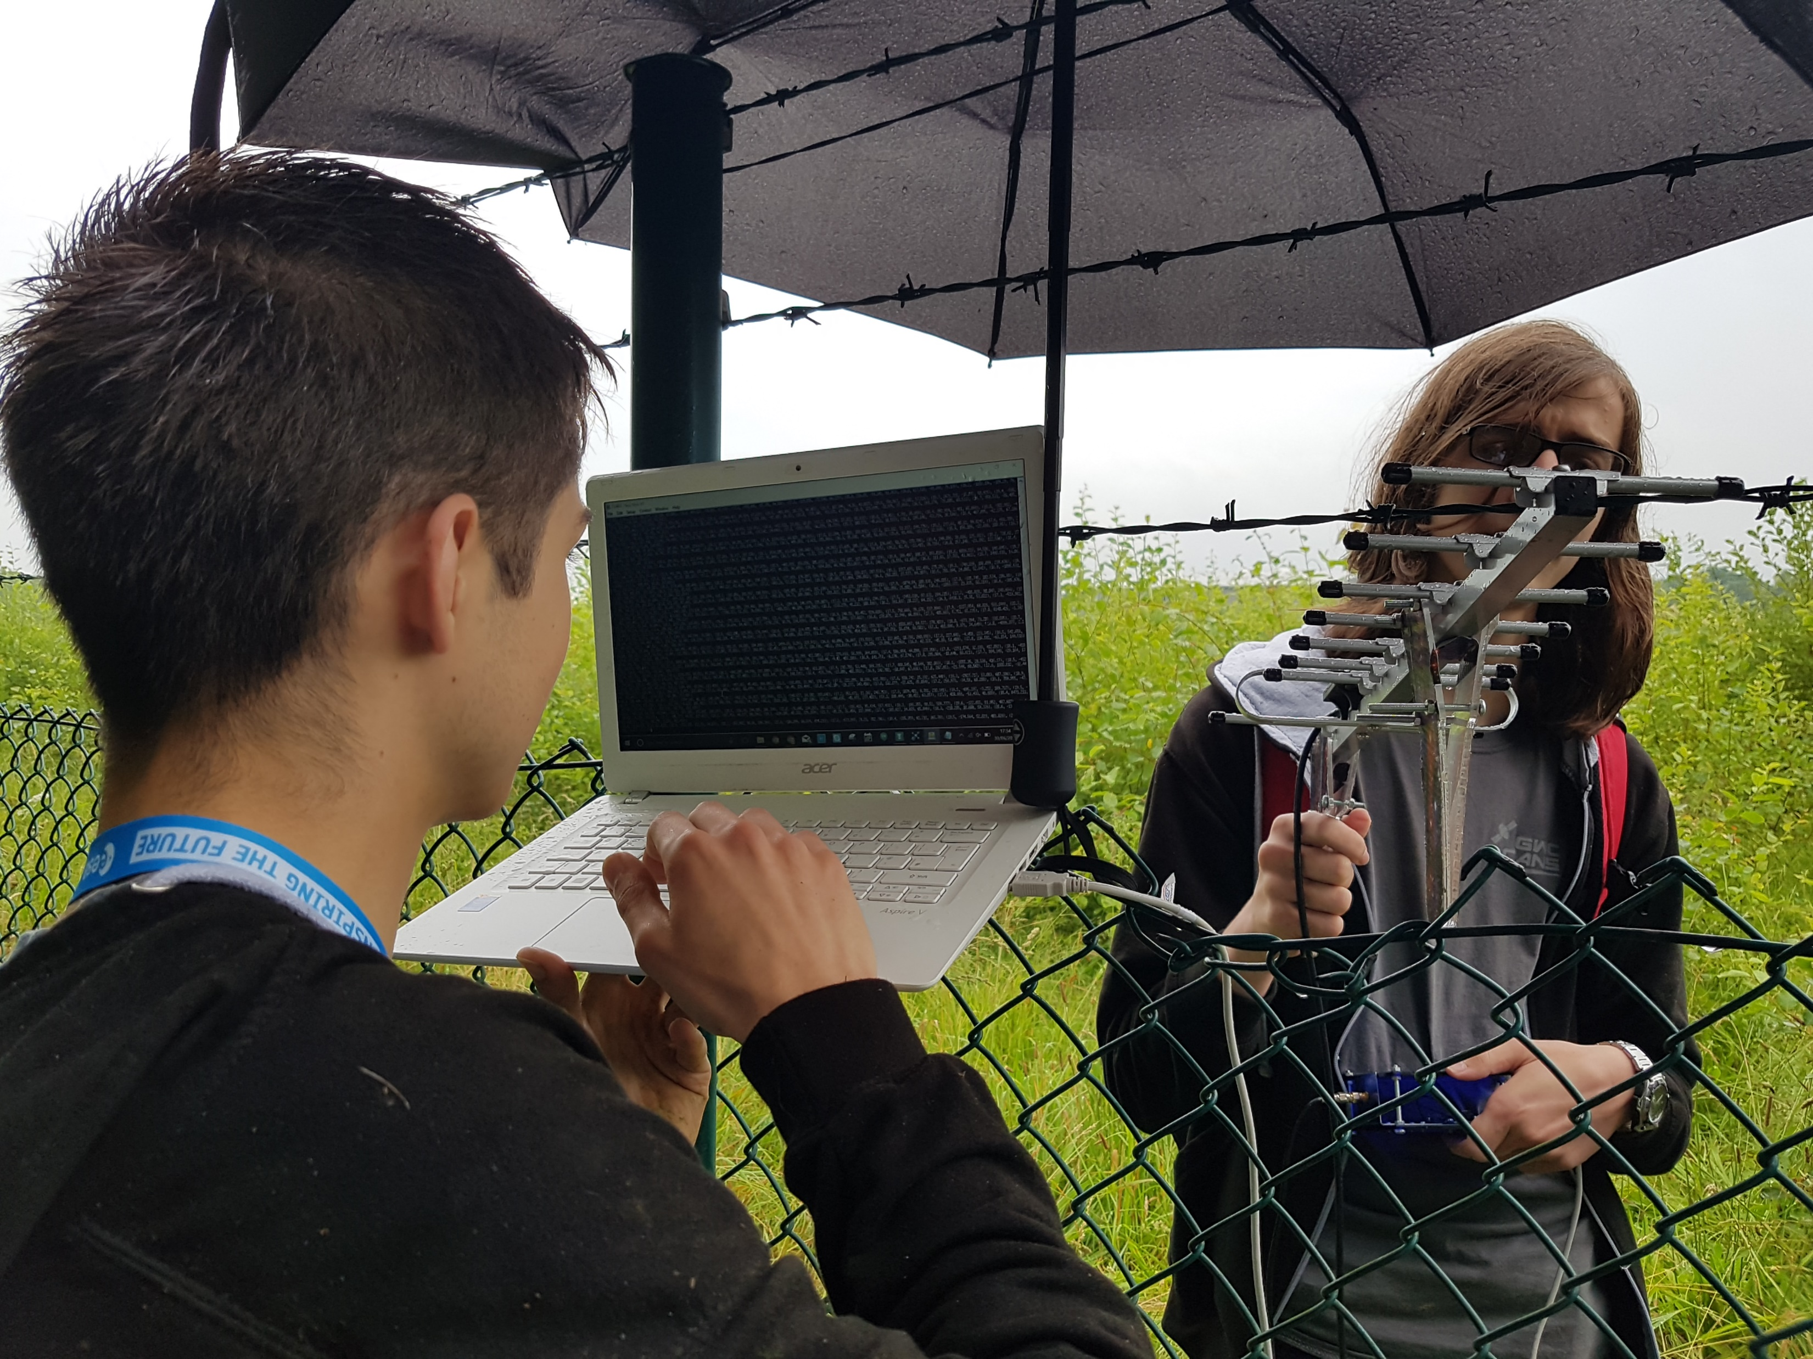
Cansat drop
Weather conditions
Rocket flight
Alternative data transmission methods
Overall success

Slide 3
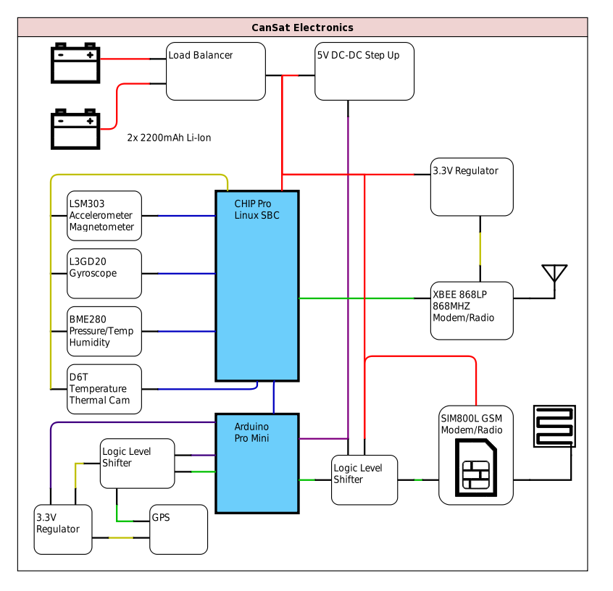
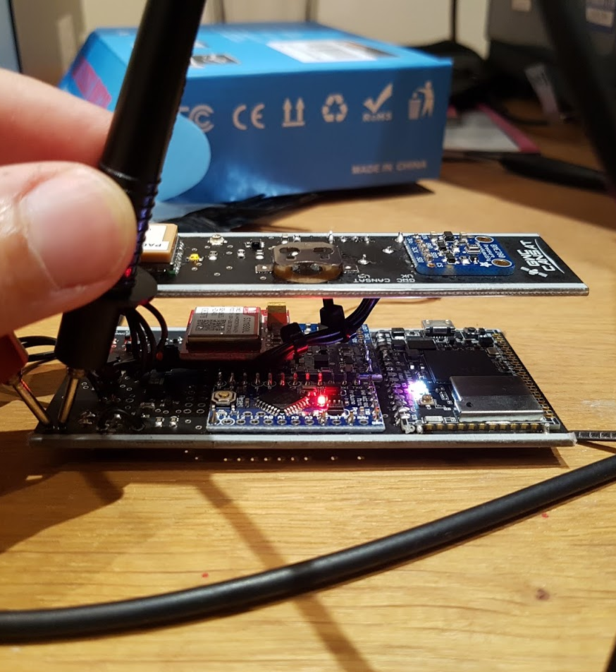
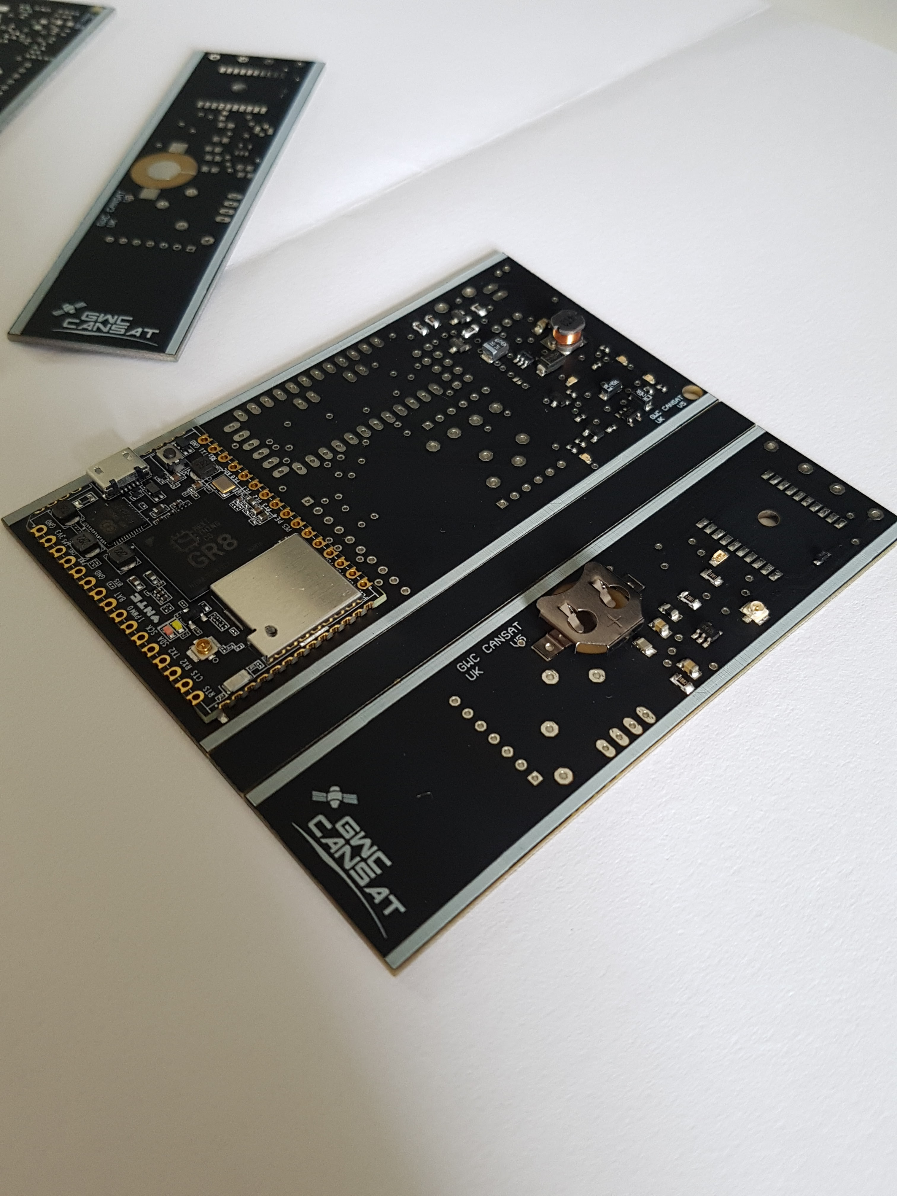
Subsystem evaluation: electronics
Reliable and Redundant
Issue-Free
CanSat fully functional through all radio contact
Intermittent GPS update
https://github.com/Arcturus314/cansat2017_design

Slide 4
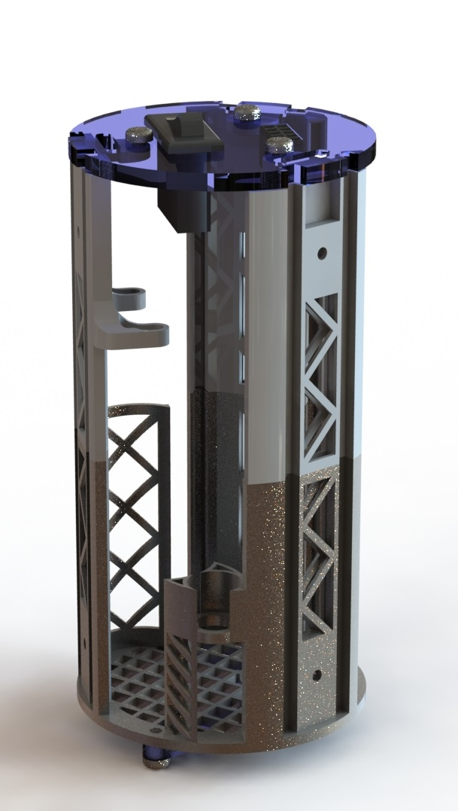
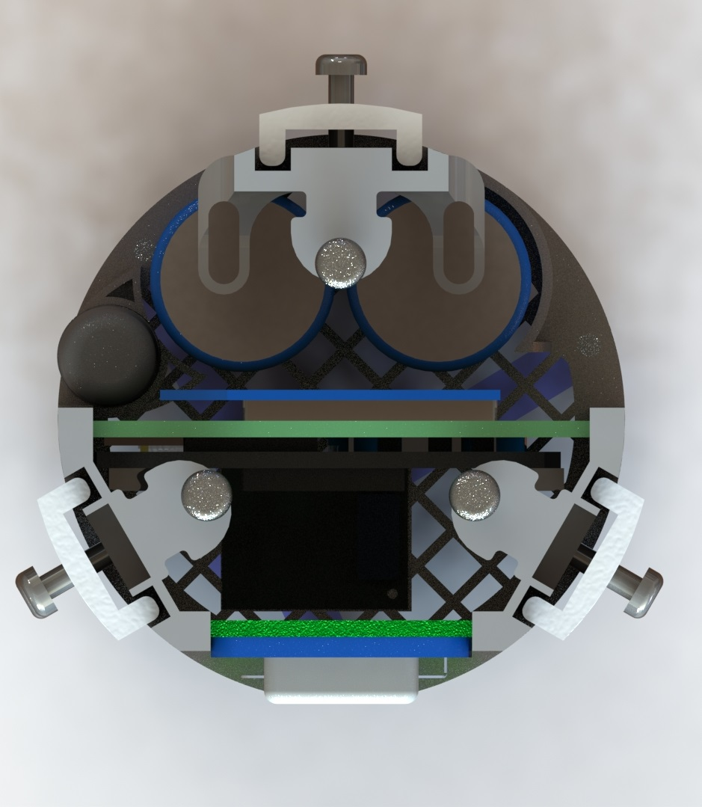
Subsystem Evaluation: internal frame
Protected CanSat without issue
No known damage post-launch
All CanSat systems functional
https://github.com/Arcturus314/cansat2017_design

Slide 5
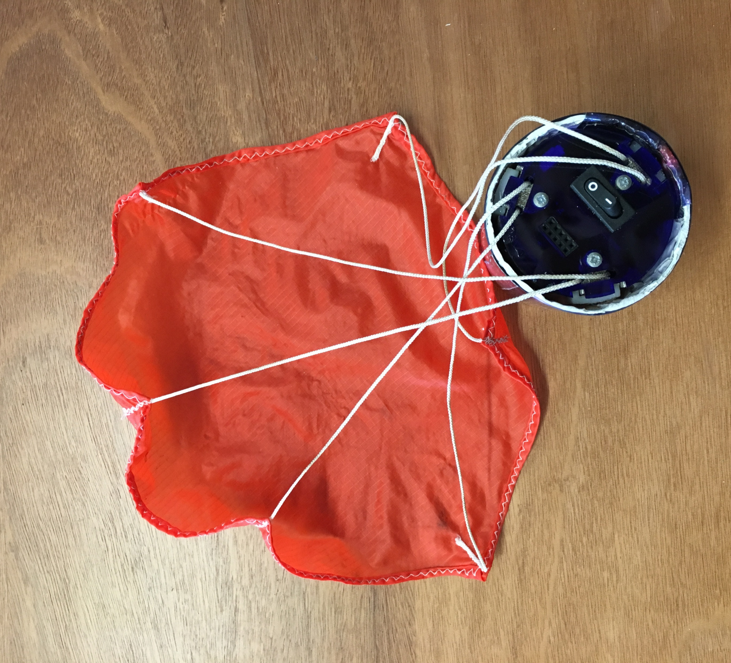
Subsystem evaluation: parachute
Helical design
Sufficient descent rate
No CanSat failures
Successful drop

Slide 6
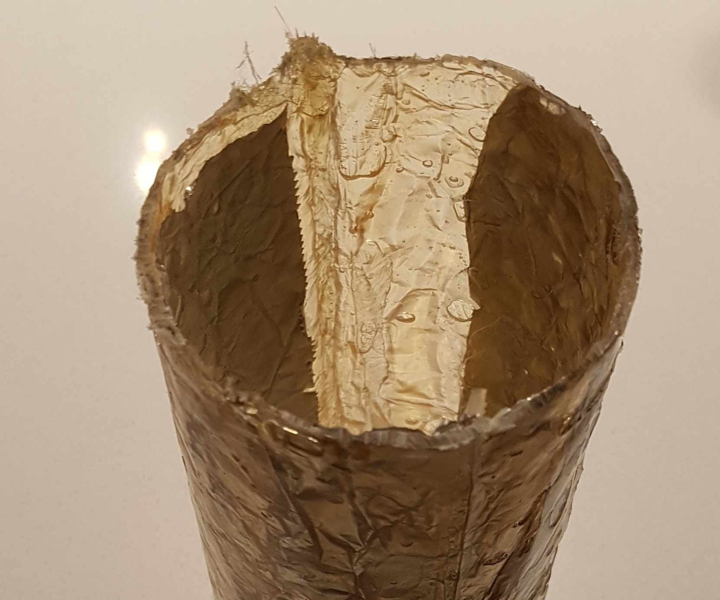
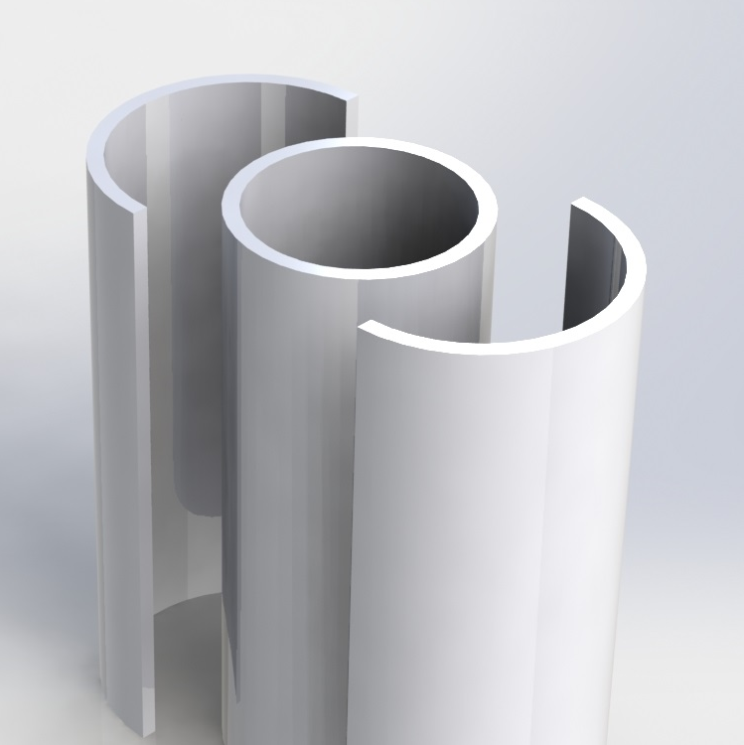
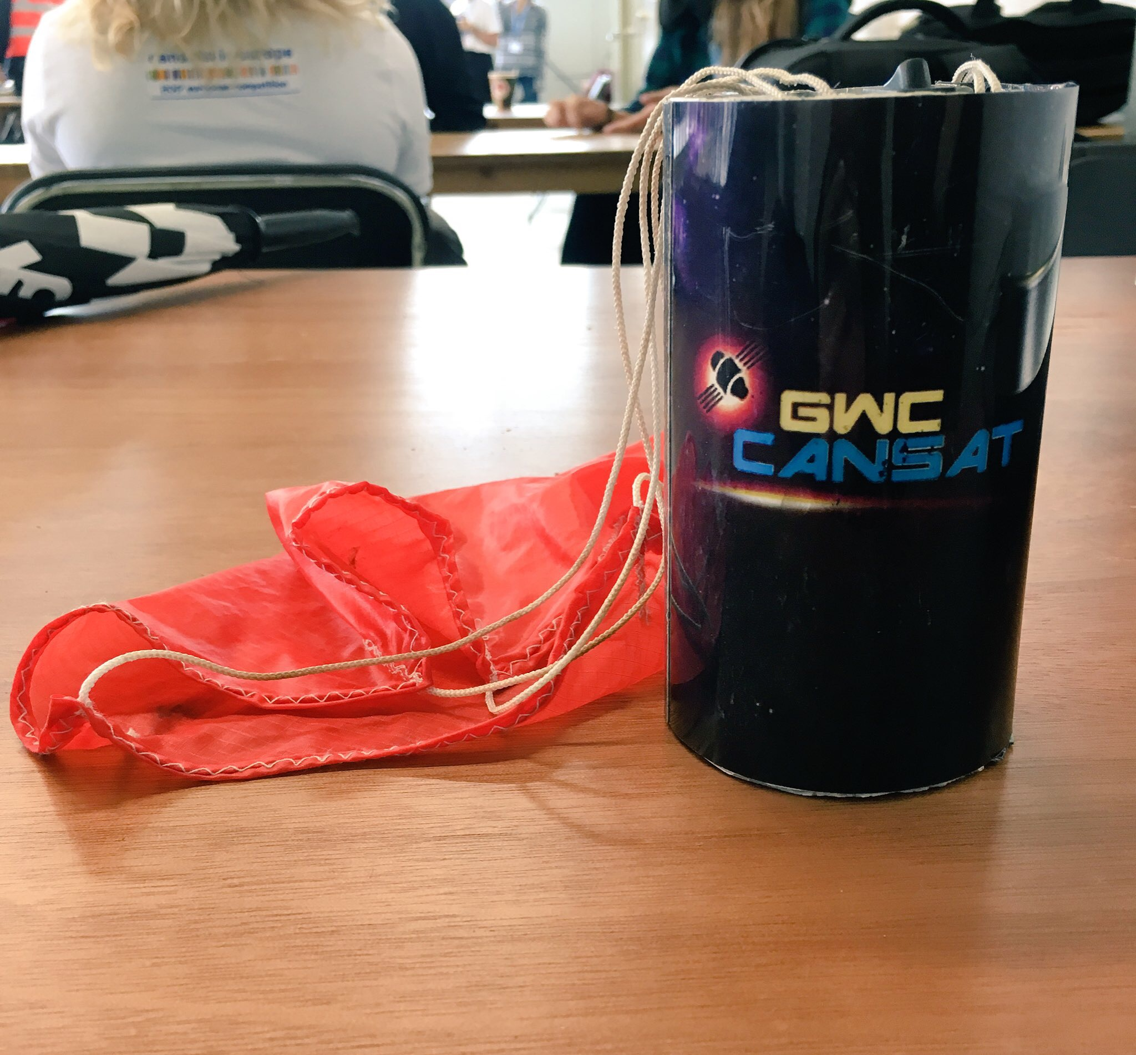
Subsystem Evaluation: outer shell
Fiberglass over PLA mold
1.5mm thick
Covered with printed plastic wrap
No damage in high-impact drop tests
Absorbed shock in CanSat tests
Protected final CanSat through mission

Slide 7
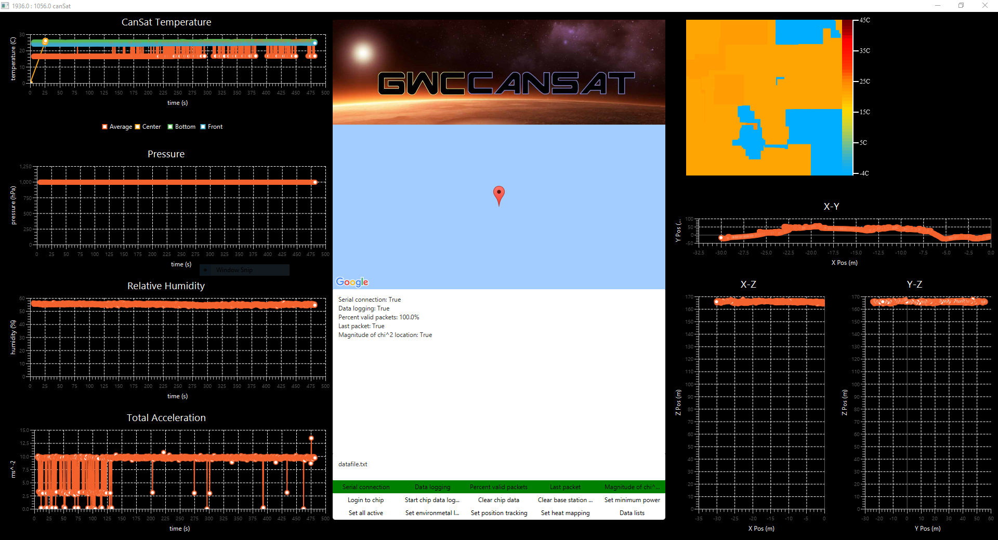
SUBSYSTEM EVALUATION: BASE STATION
Java / JavaFX
Real-time Graphing
CanSat Control
Issue-Free through mission
https://github.com/Arcturus314/cansat2017

Slide 8
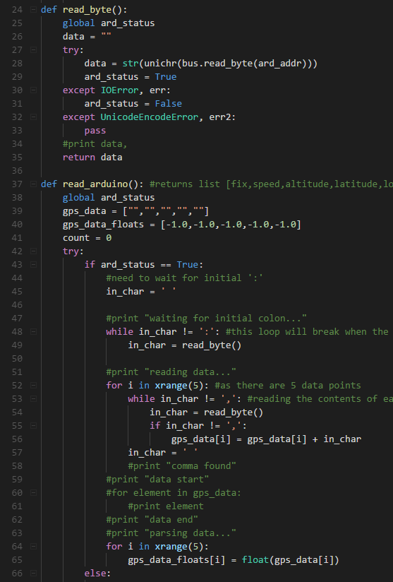
Subsystem evaluation: cansat software
Python and C++
Multiple levels of abstraction
Proved to be reliable
No datalogging, communication, or update failures during the mission

Slide 9
Primary mission
Humidity, Temperature, Pressure
IMU Temperature disregarded
Functional sensor operation
Constant altitude over data

Slide 11
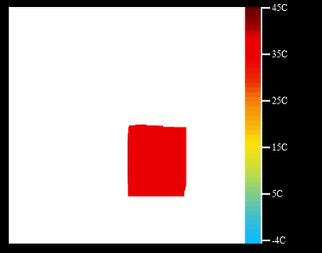
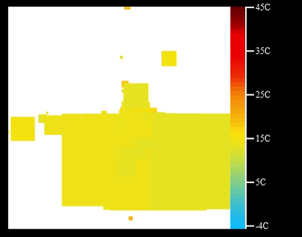
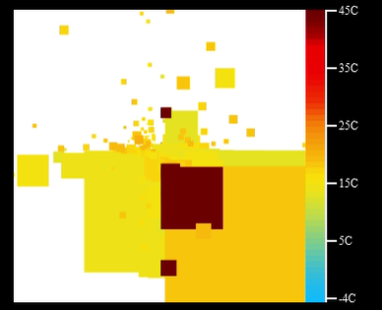
Secondary mission: Heat map
Launch and drop
Algorithm functioned as intended
Block of “hot” data at center: rocket visible

Slide 12
STATUS TELEMETRY
Small sensor communication drops
Due to overall program flow
No system errors

Slide 13
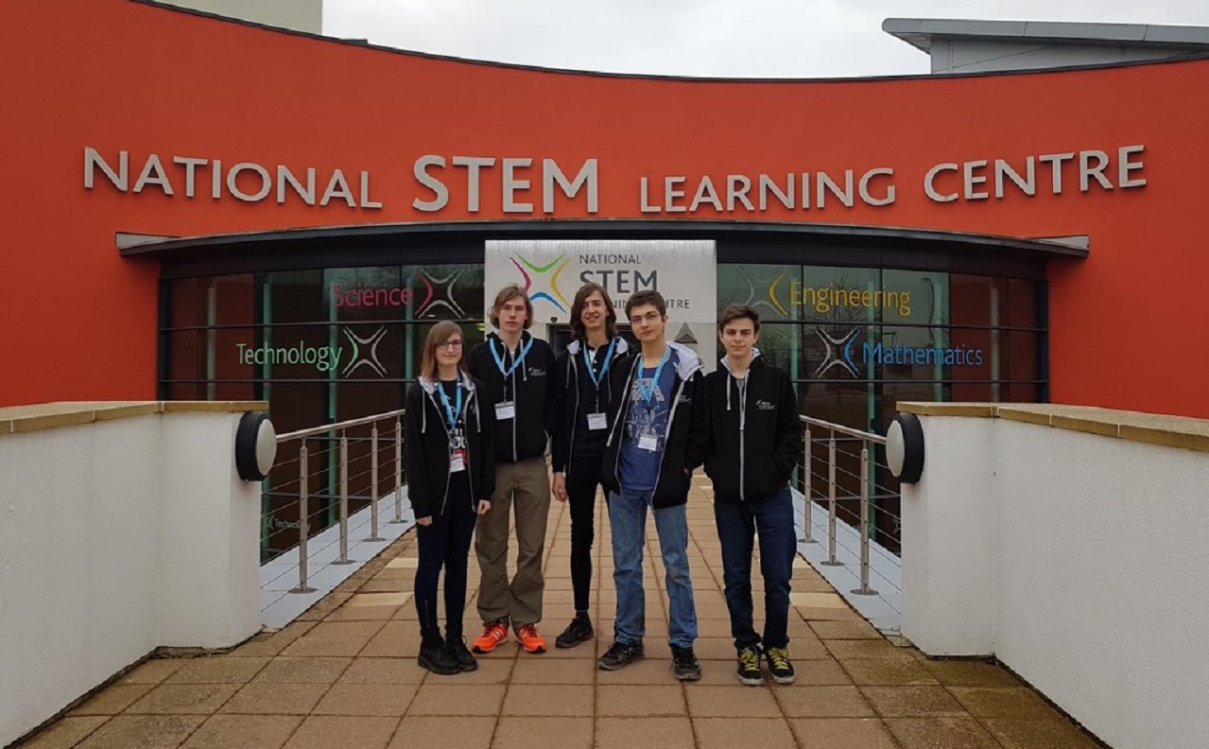
Overall reflection
Received data and system information
Small data set
Difficulty in identifying trends
Overall a success
Future improvements

Slide 14










Thank you

Slide 15
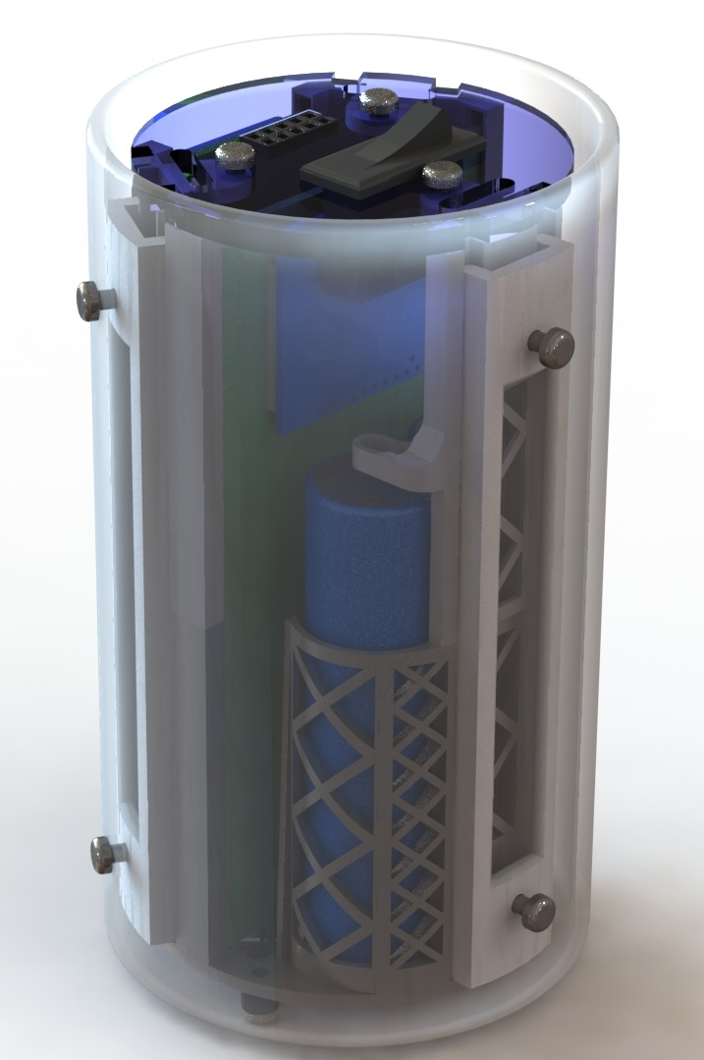
overview
Mission Objectives
Monitor atmospheric variables
Create temperature map of surface below CanSat
1GHz ARM
Pressure, Humidity, Temperature, IMU, Thermal Camera
Redundant Radios

Slide 16
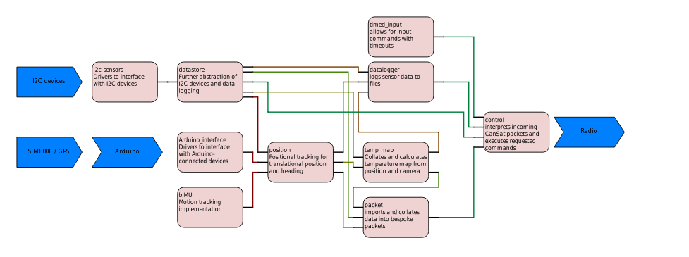
CANSAT PROGRAMMING
Python and C++
2700+ lines of code
Modular
Feature-Packed
https://github.com/Arcturus314/cansat2017

Slide 17
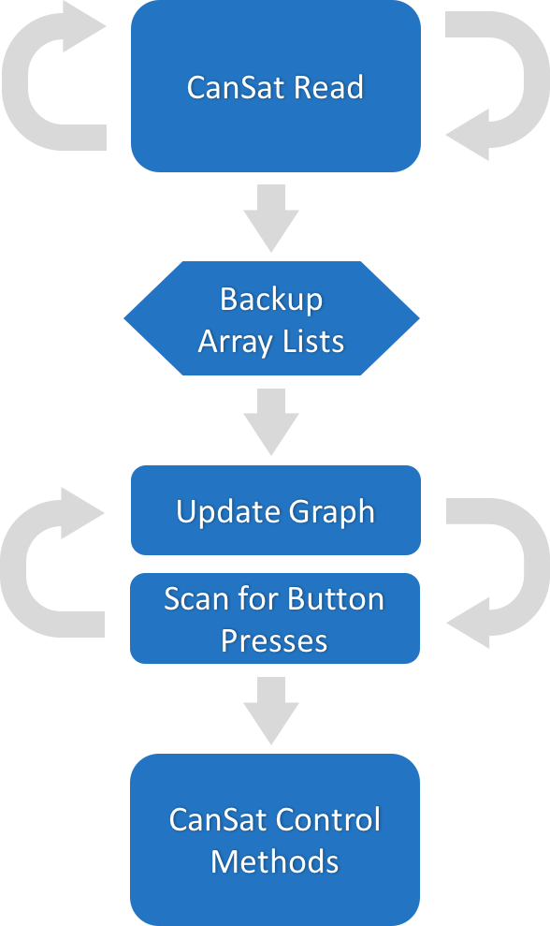
Base station
Java / JavaFX
Real-Time Graphing
CanSat Control
https://github.com/Arcturus314/cansat2017

Slide 18
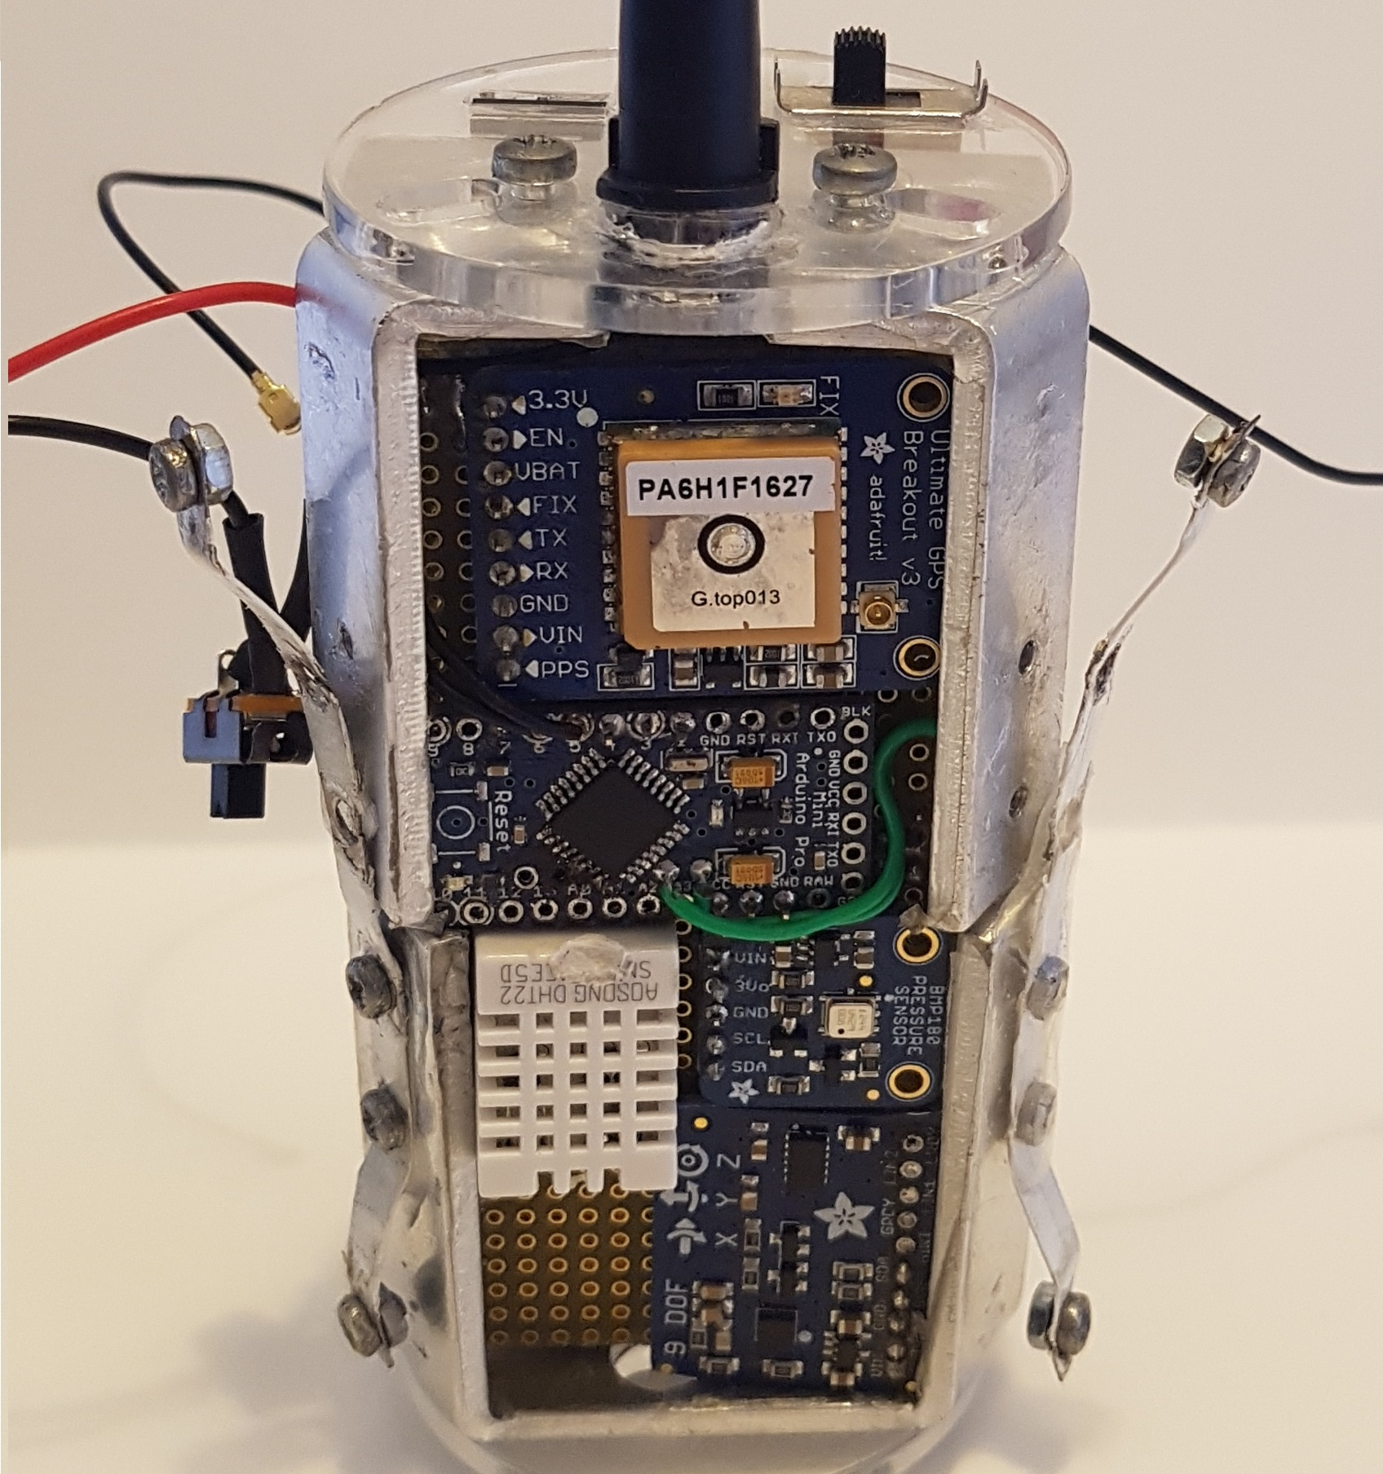
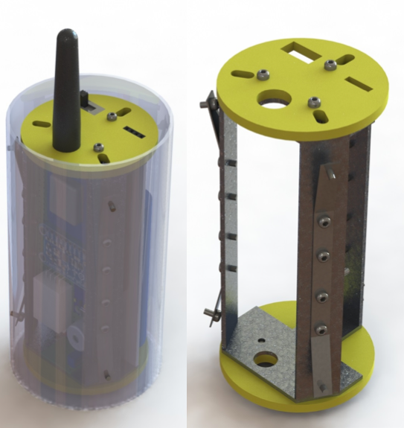
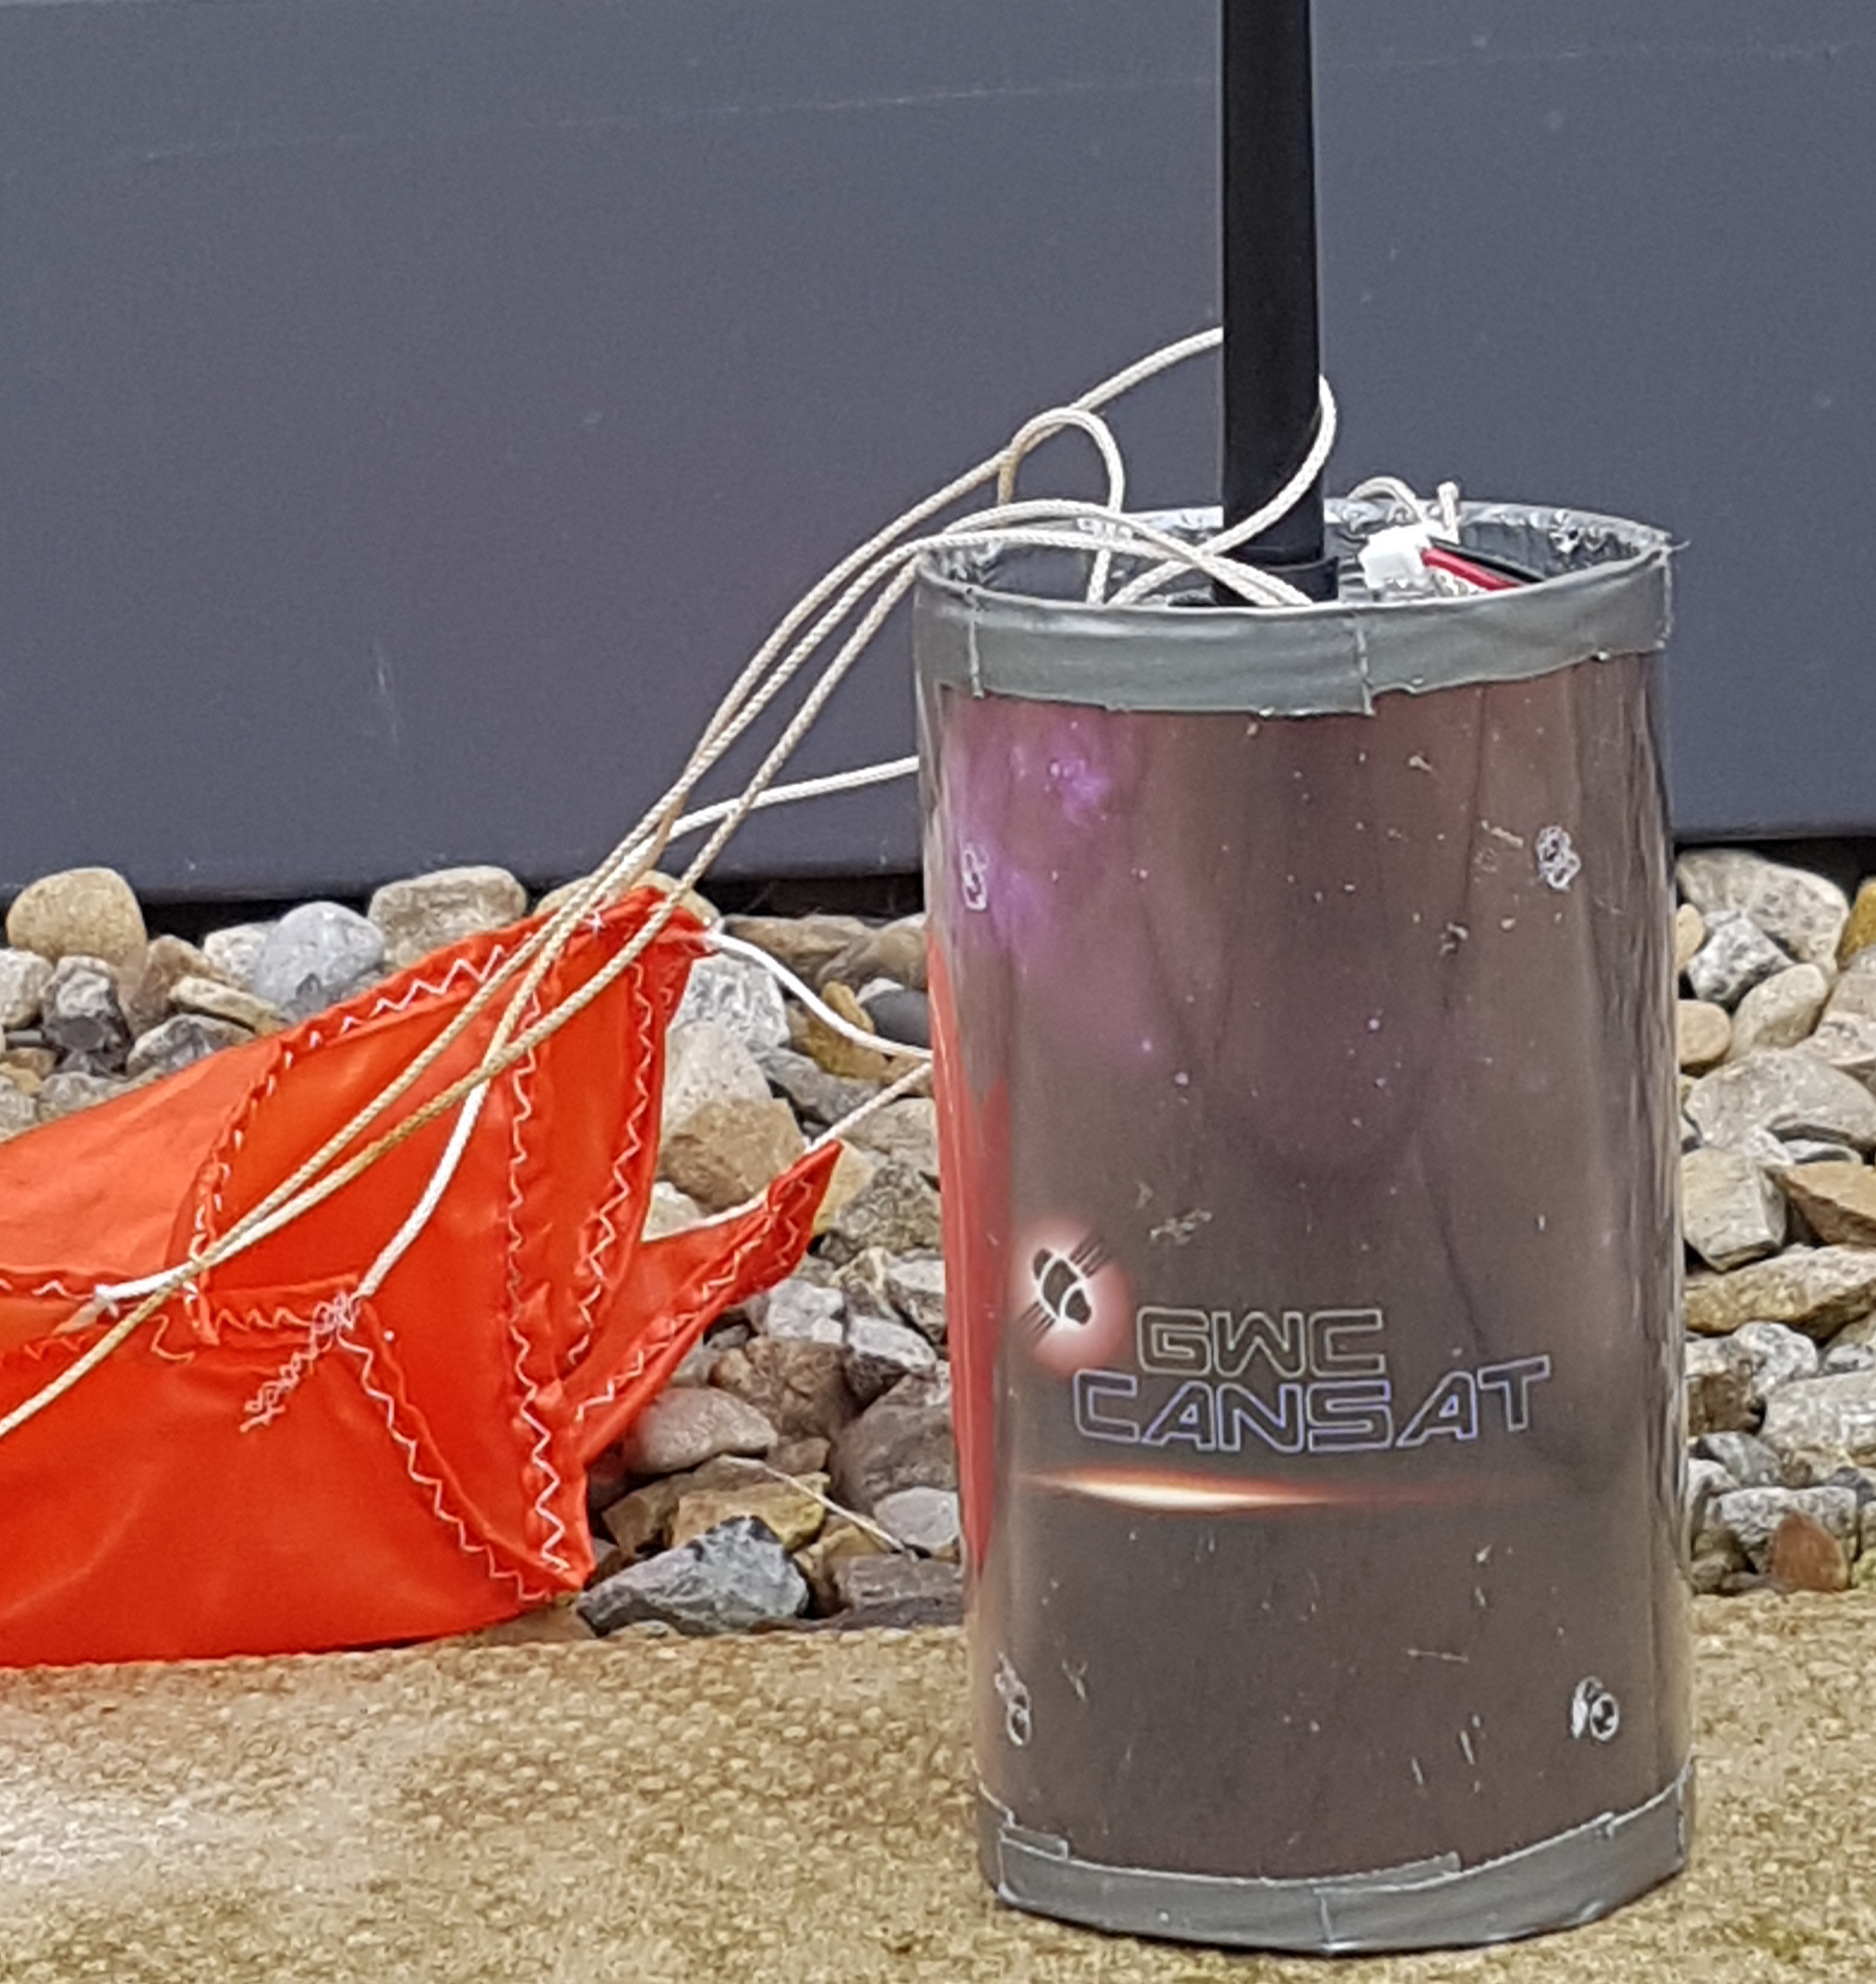
Prototype CanSat
Larger SBC
Hand-Wired
Discrete Sensors
Bent aluminum and laser-cut acrylic frame
Fiberglass shell

Slide 19
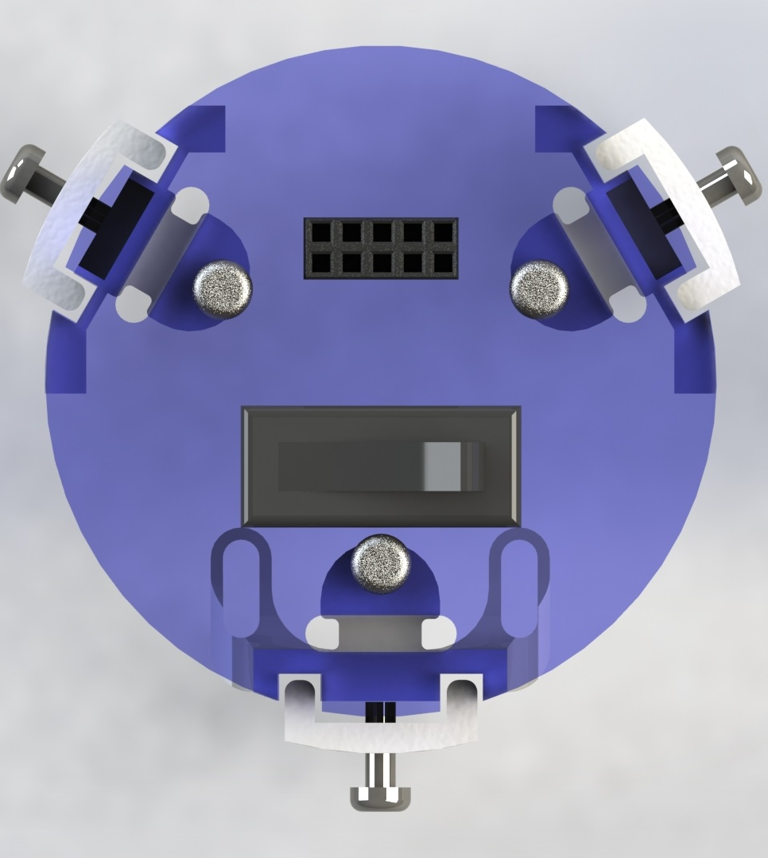
Final cansat
New SBC and smaller sensors
3D printed steel and nylon frame
Custom PCBs
Rewritten software

Slide 20
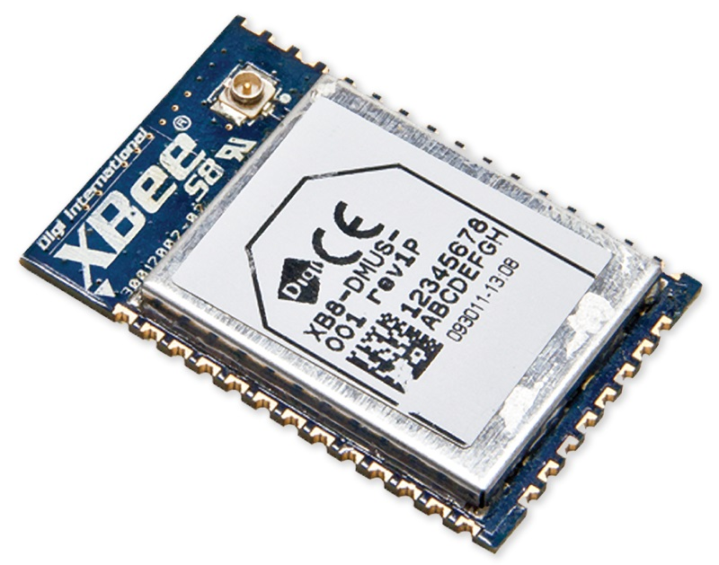
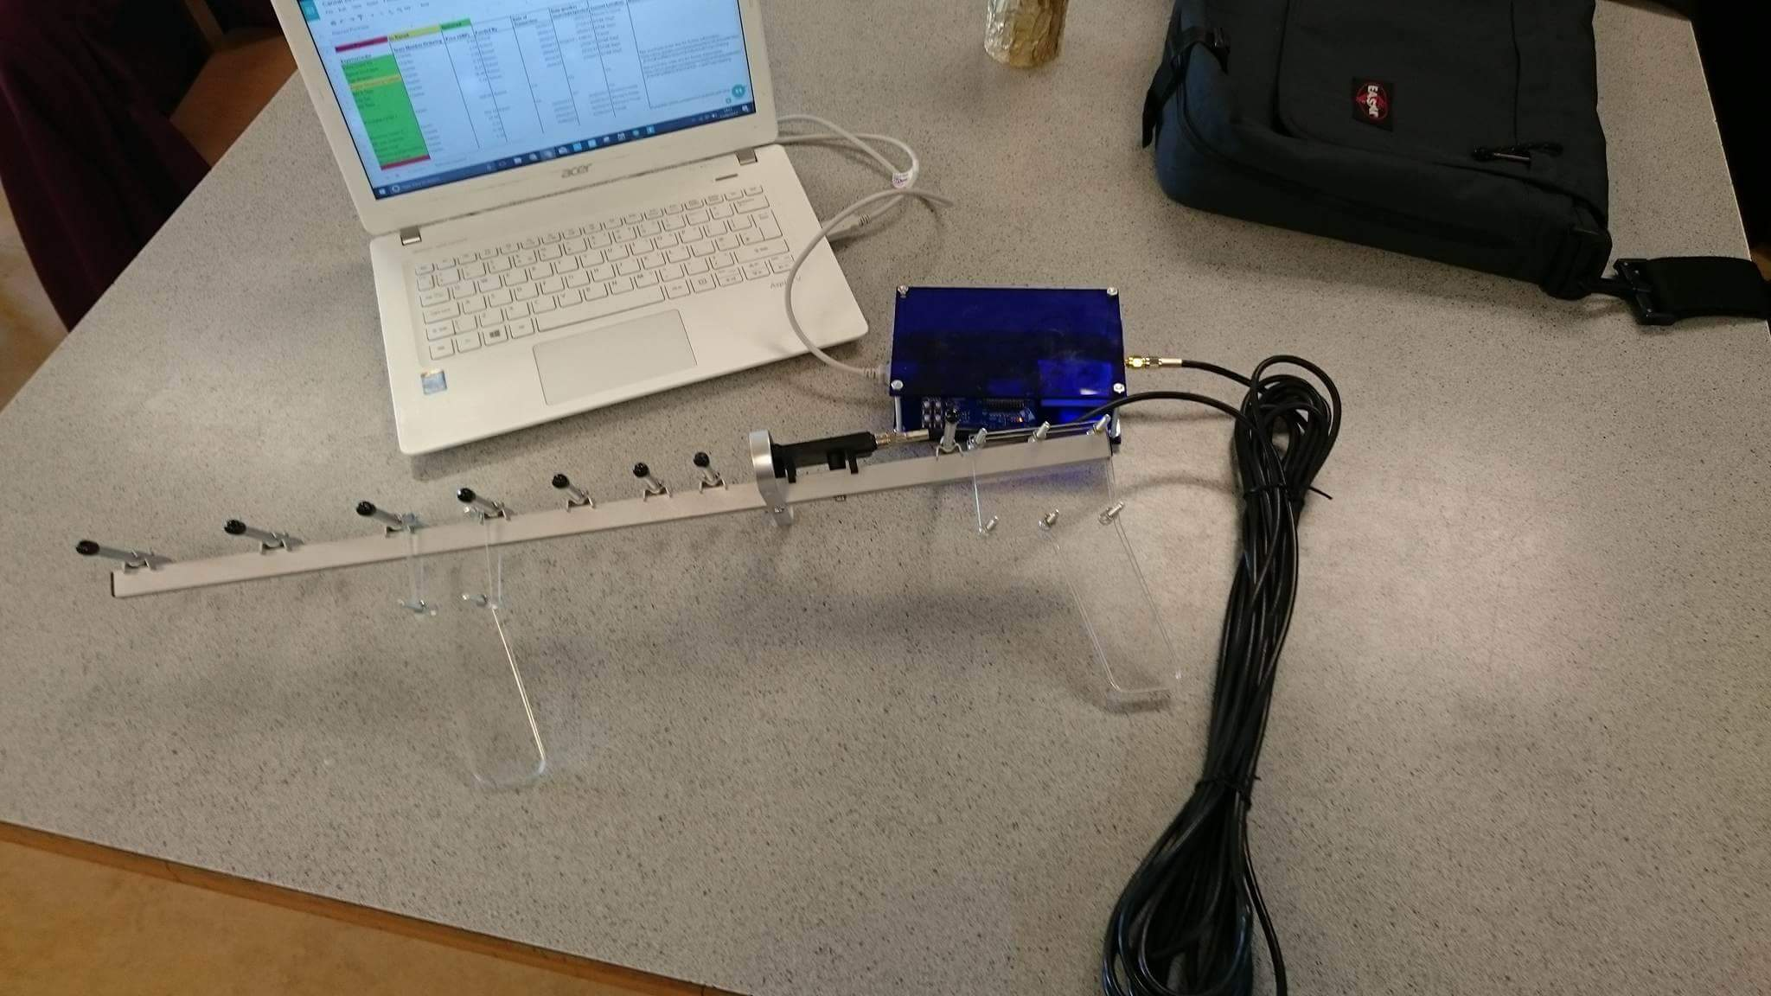
Radio
XBEE 868LP For Europe
5km rated range
10kbps transfer speed
Mesh networking
CanSat: u.fl duck antenna
Base Station: Yagi-Uda 11dBm

Slide 21
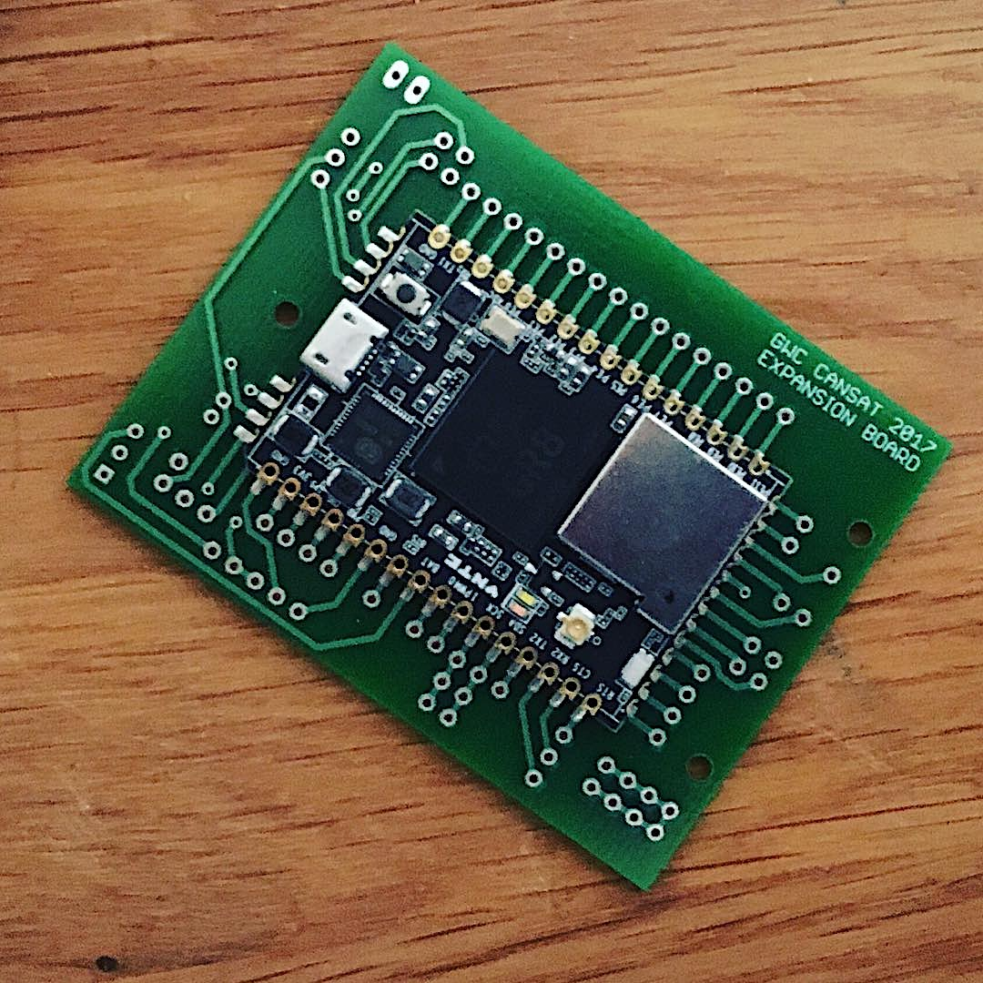
Expansion
Multi-node mesh network
Interconnected sensor arrays
Real-world applications
Expansion board with:
CHIP Pro
Li-Ion Battery
XBEE
3.3V Sensors

Slide 22
Primary mission
Design Criteria
Accurate and Precise
No sensor failures
Possible to post-process data
Evaluation
PASS
Positives
Negatives

Slide 23
Secondary mission: thermal camera
Design Criteria
I2C bus
Wiring and Connectors
Sensor Status
Data Processing
Evaluation
PASS
Positives
Negatives

Slide 24
Secondary mission: motion tracking
Design Criteria
IMU Sensors
Fusion Algorithm
Barometer and GPS Bounding
Drift Compensation
Evaluation
PASS
Positives
Negatives

Slide 25
Graphs for x pos, y pos, z pos, orientation v time

Slide 26
Secondary mission: thermal mapping
Design Criteria
IMU Sensors
Fusion Algorithm
Barometer and GPS Bounding
Drift Compensation
Evaluation
PASS
Positives
Negatives
Thermal map here

Slide 27
Overall reflection

